Slide 1
Revenue | 325,539
Expenses | -120,930
Cost of sales | -12,842
Other Income | 23,048
Tax Paid | -14,754
Change in fixed Assets | 23,615
Adjustments | -854
Total | =sum(

Slide 2
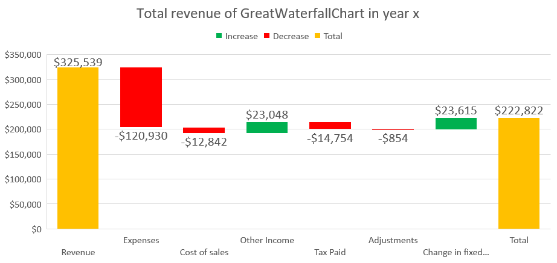
Expenses take up more than 1/3 of our total revenue
Exercise: Waterfall with 1 total

Slide 3
1. Add a Waterfall Chart and sum the Total Value
2. Make sure there are only 2 totals
3. Use color coding
4. Make data labels display currency

